Slide 1
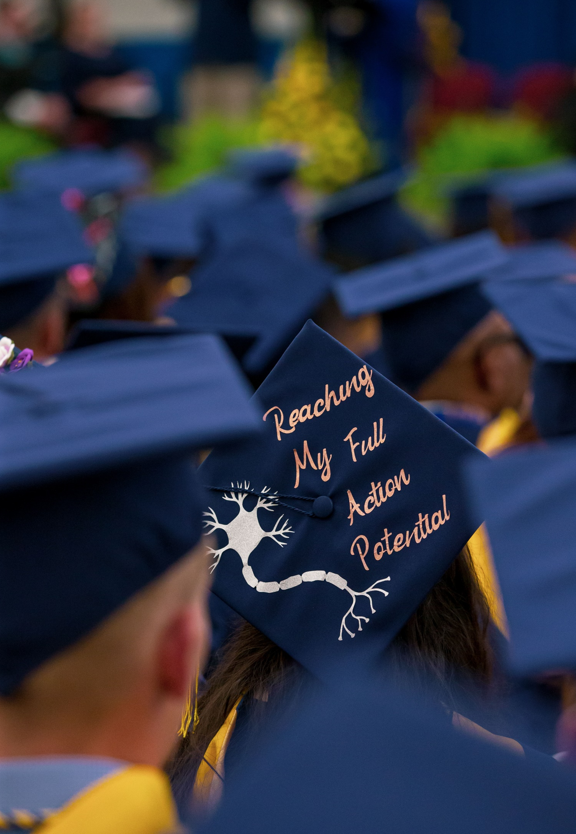
Countdown to Commencement
Everything you need to know about graduation
Deadlines, Traditions, and More!

Slide 2
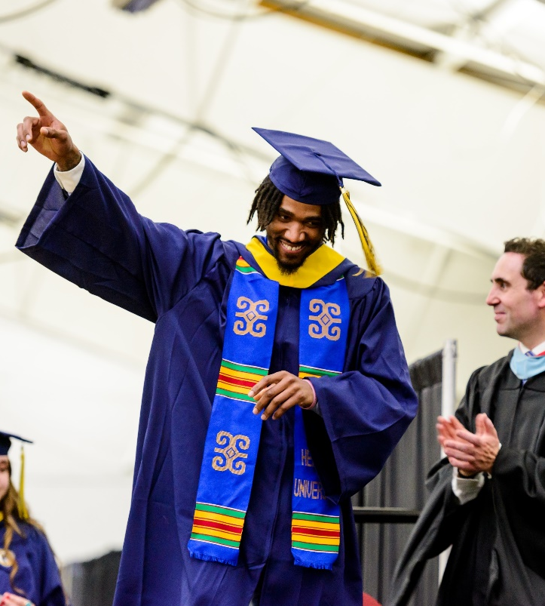
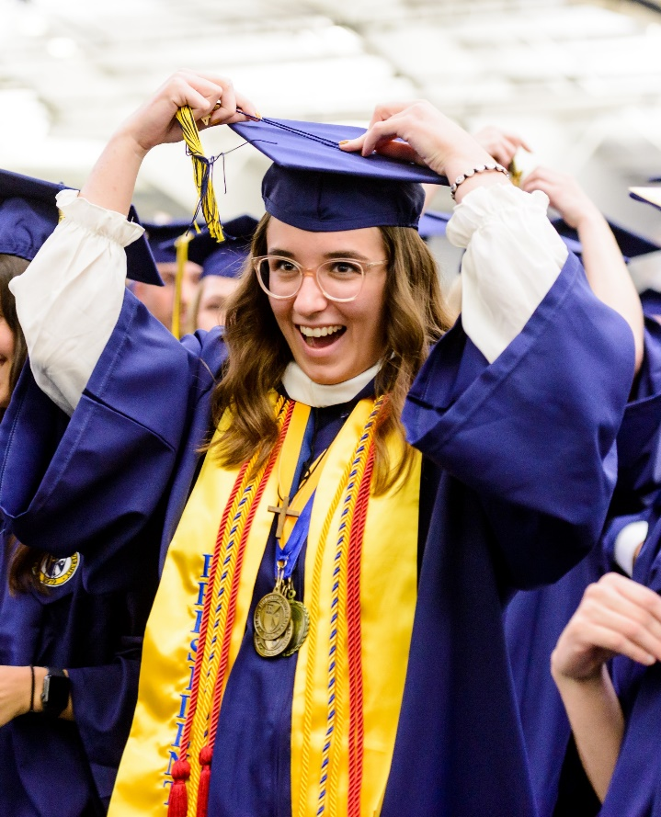
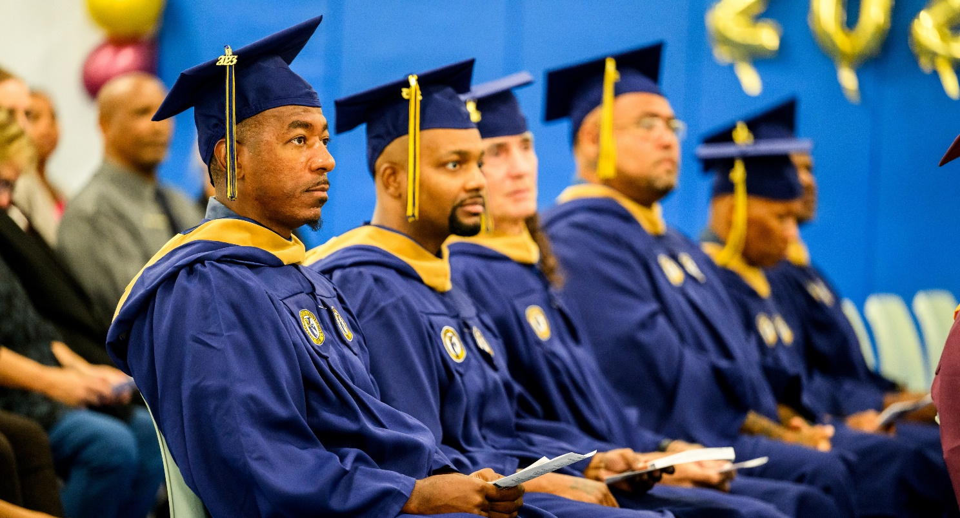
Important Dates
Friday, March 1
Deadline to Apply for May Graduation
Sunday, April 7
Online Regalia Ordering Closes
Sunday, April 14
Deadline to submit the Commencement Early Participation Form
Thursday, April 25
Lavender Ceremony – 5:30pm - 7:00pm
Friday, April 26
Honors Convocation – 2:00pm
Torch Night – 6:00pm
Saturday, April 27
Senior Social – 5:00pm - 8:00pm
Saturday, May 4
Baccalaureate Mass – 9:30am - 10:30am
Graduation Brunch – 10:00am - 1:00pm
SHU Global: Meet and Greet with Advisors – 11:00am - 1:00pm
Kente Ceremony – 11:00am - 12:00pm
University Commencement – 2:00pm

Slide 3
WHAT’S THE DIFFERENCE? Applying to Graduate vs Commencement
Application for Graduation
Commencement & Ticket Ordering
Graduation - The receiving or conferring of an academic degree or diploma
SHU has 3 Graduations (August, December, and May)
Every student must fill out the graduation application to receive their diploma and be granted their degree
Commencement - A symbolic ceremony where graduates are recognized for their accomplishments
SHU has 1 Commencement Ceremony (May)
To notify SHU that you will be participating in Commencement, you must complete the ticket registration form

Slide 4
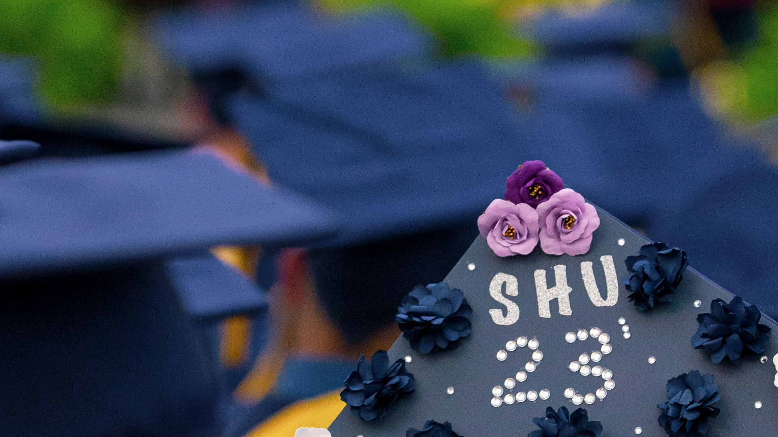
When should I complete my application for graduation?
Requirements:
Undergraduate – Students must have completed 88 or more hours of coursework with a minimum 2.0 cumulative GPA
Graduate – Students must have completed 24 or more hours of coursework with a minimum 3.0 cumulative GPA
Graduation Sessions and deadlines:
If your requirements will be met at the end of the Winter semester, apply for May graduation by March 1st
If your requirements will be met at the end of the Summer semester, apply for August graduation by June 30th
If your requirements will be met at the end of the Fall semester, apply for December graduation by September 30th

Slide 5
Application for Graduation
Candidates for a degree must submit a formal Graduation Application before a degree can be awarded
Where to find the Graduation Application
MySiena > Academic Information > Application for Graduation

Slide 6
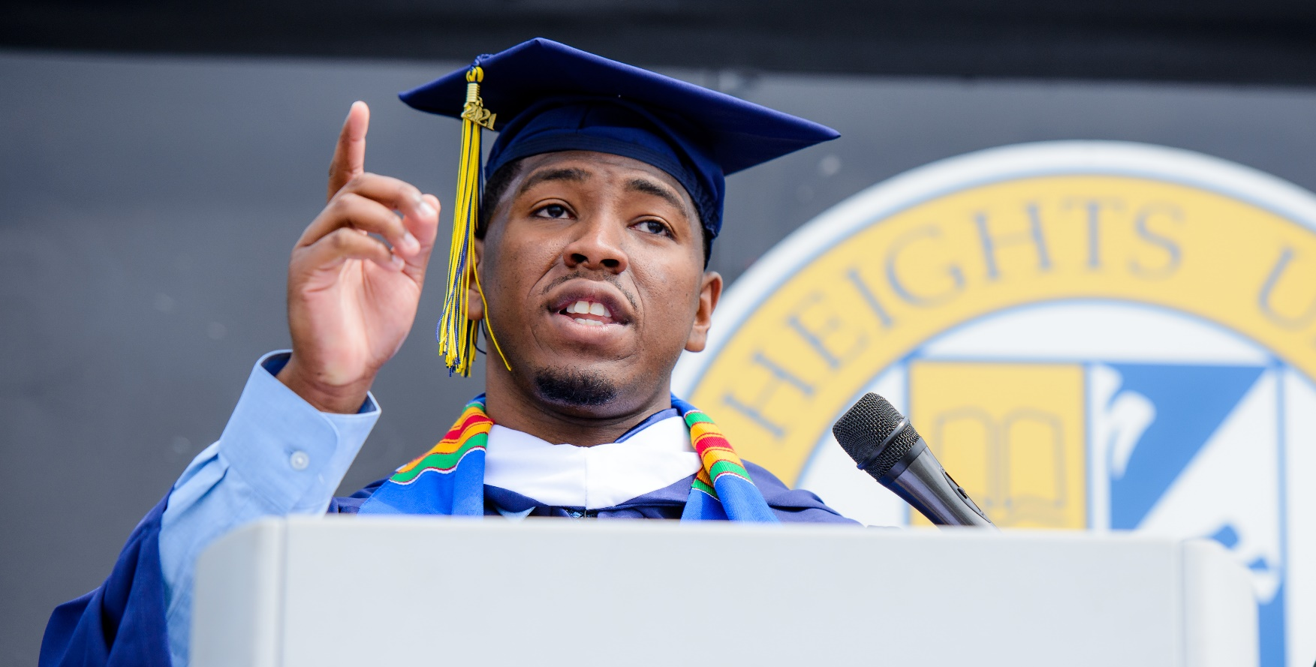
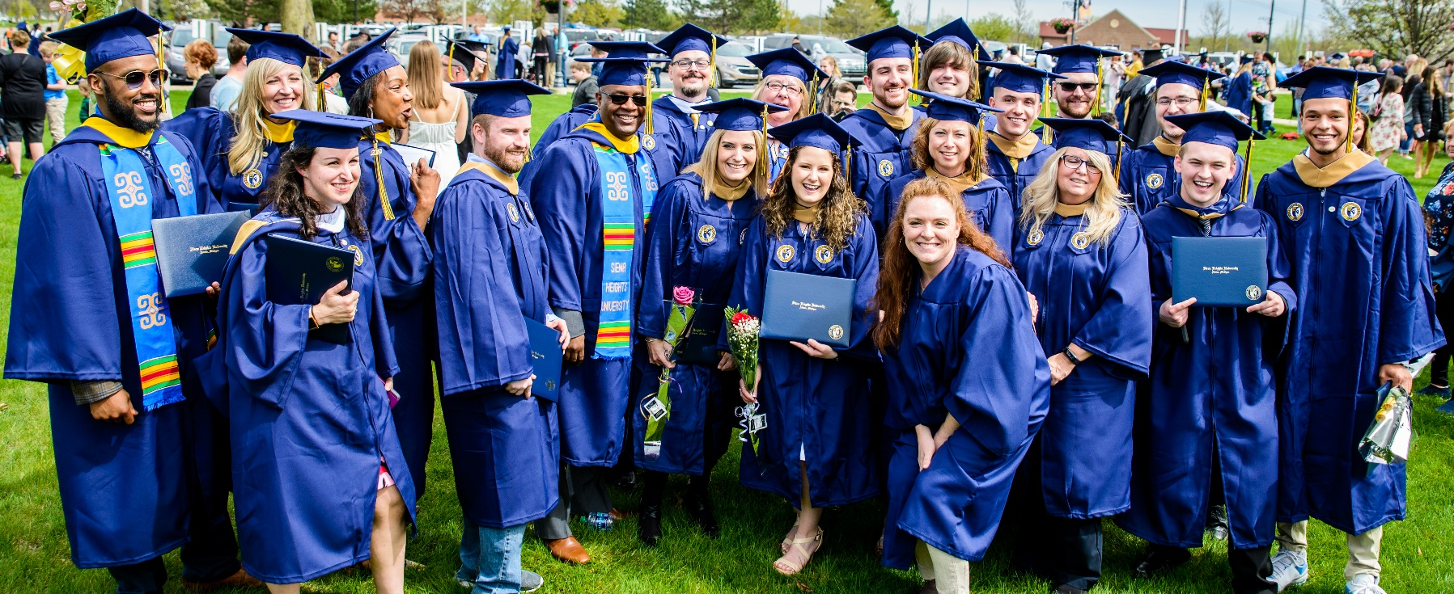
The University Commencement Ceremony
Held at the Adrian Campus of Siena Heights University, in the University Fieldhouse
Saturday, May 4 at 2:00p.m. Commencement for all graduating students at SHU
Commencement will also be livestreamed – Link can be found on the commencement website

Slide 7
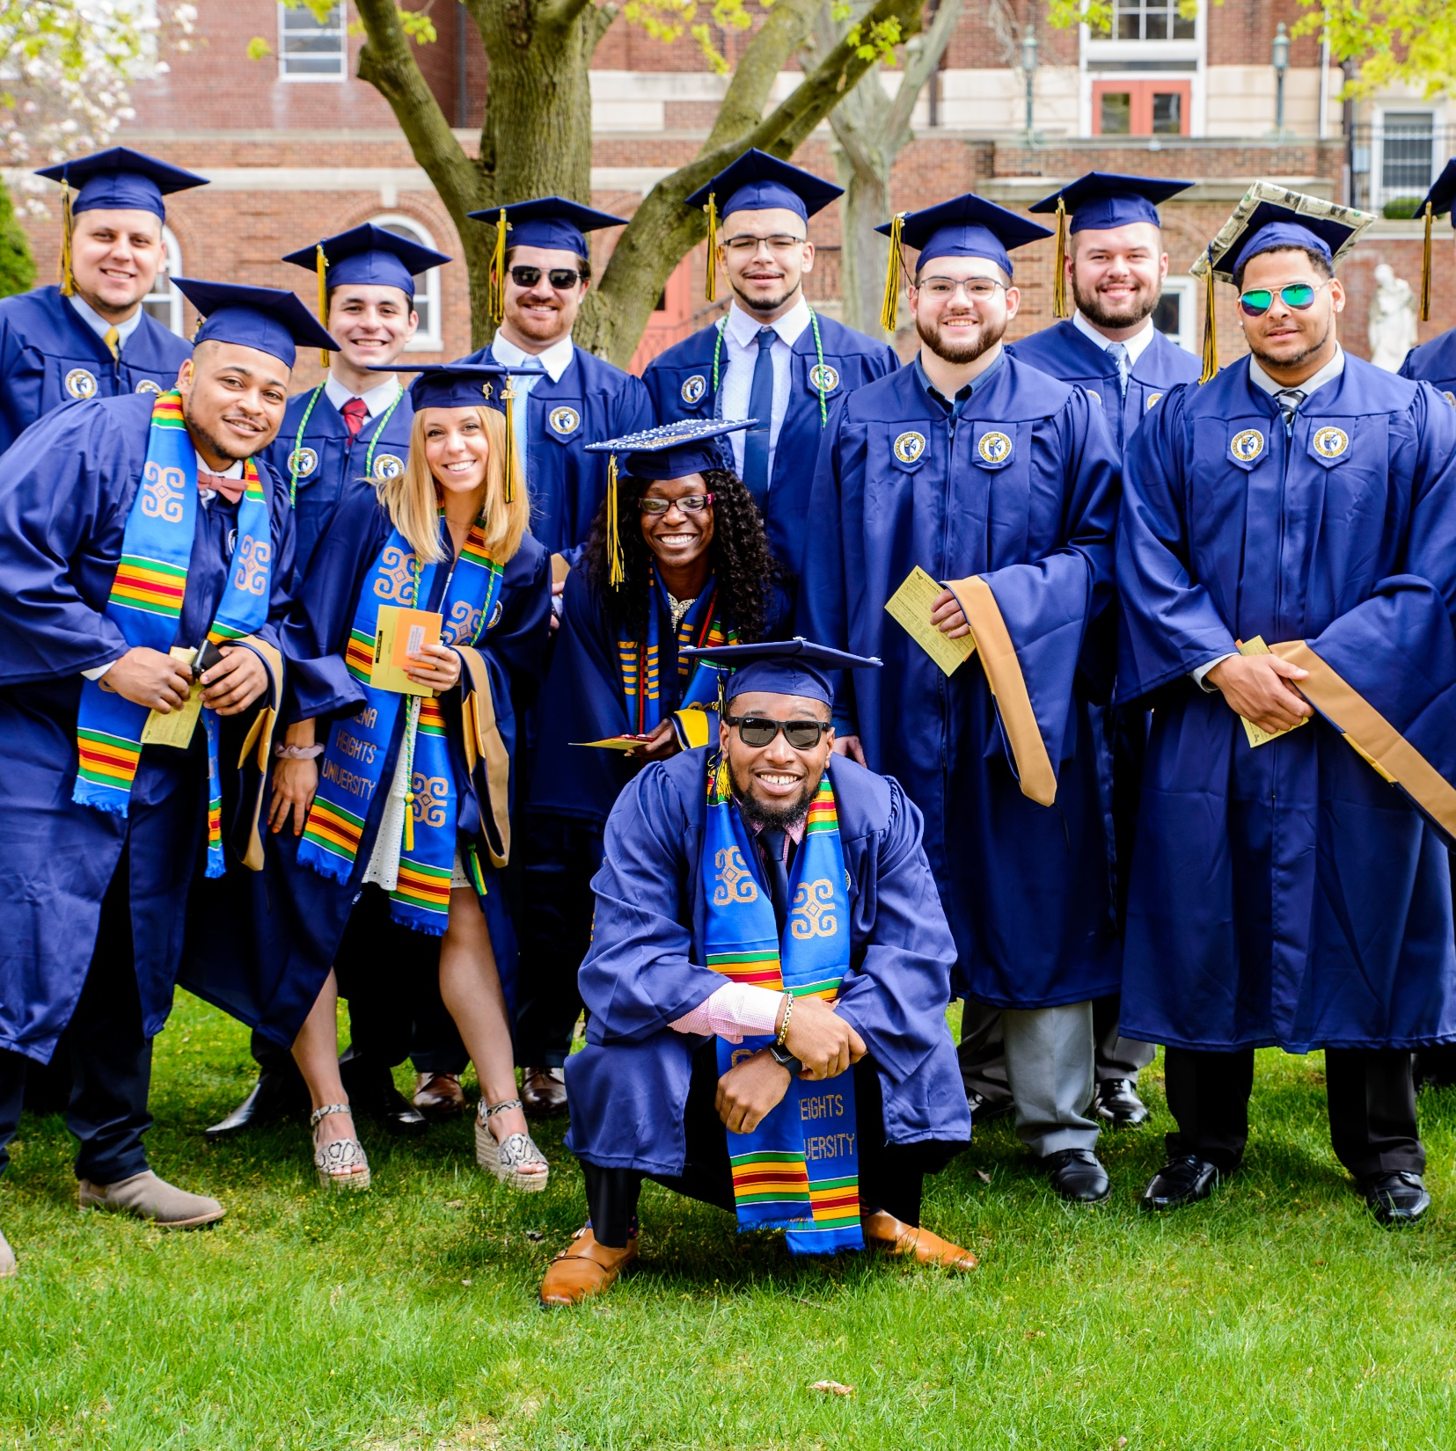
Commencement Tickets and Sign-Up
Each student walking in commencement will receive 8 guest tickets
Tickets are FREE!
By completing the Ticket Registration Form, you are telling Siena Heights University that you will be participating/walking on Commencement Day

Slide 8
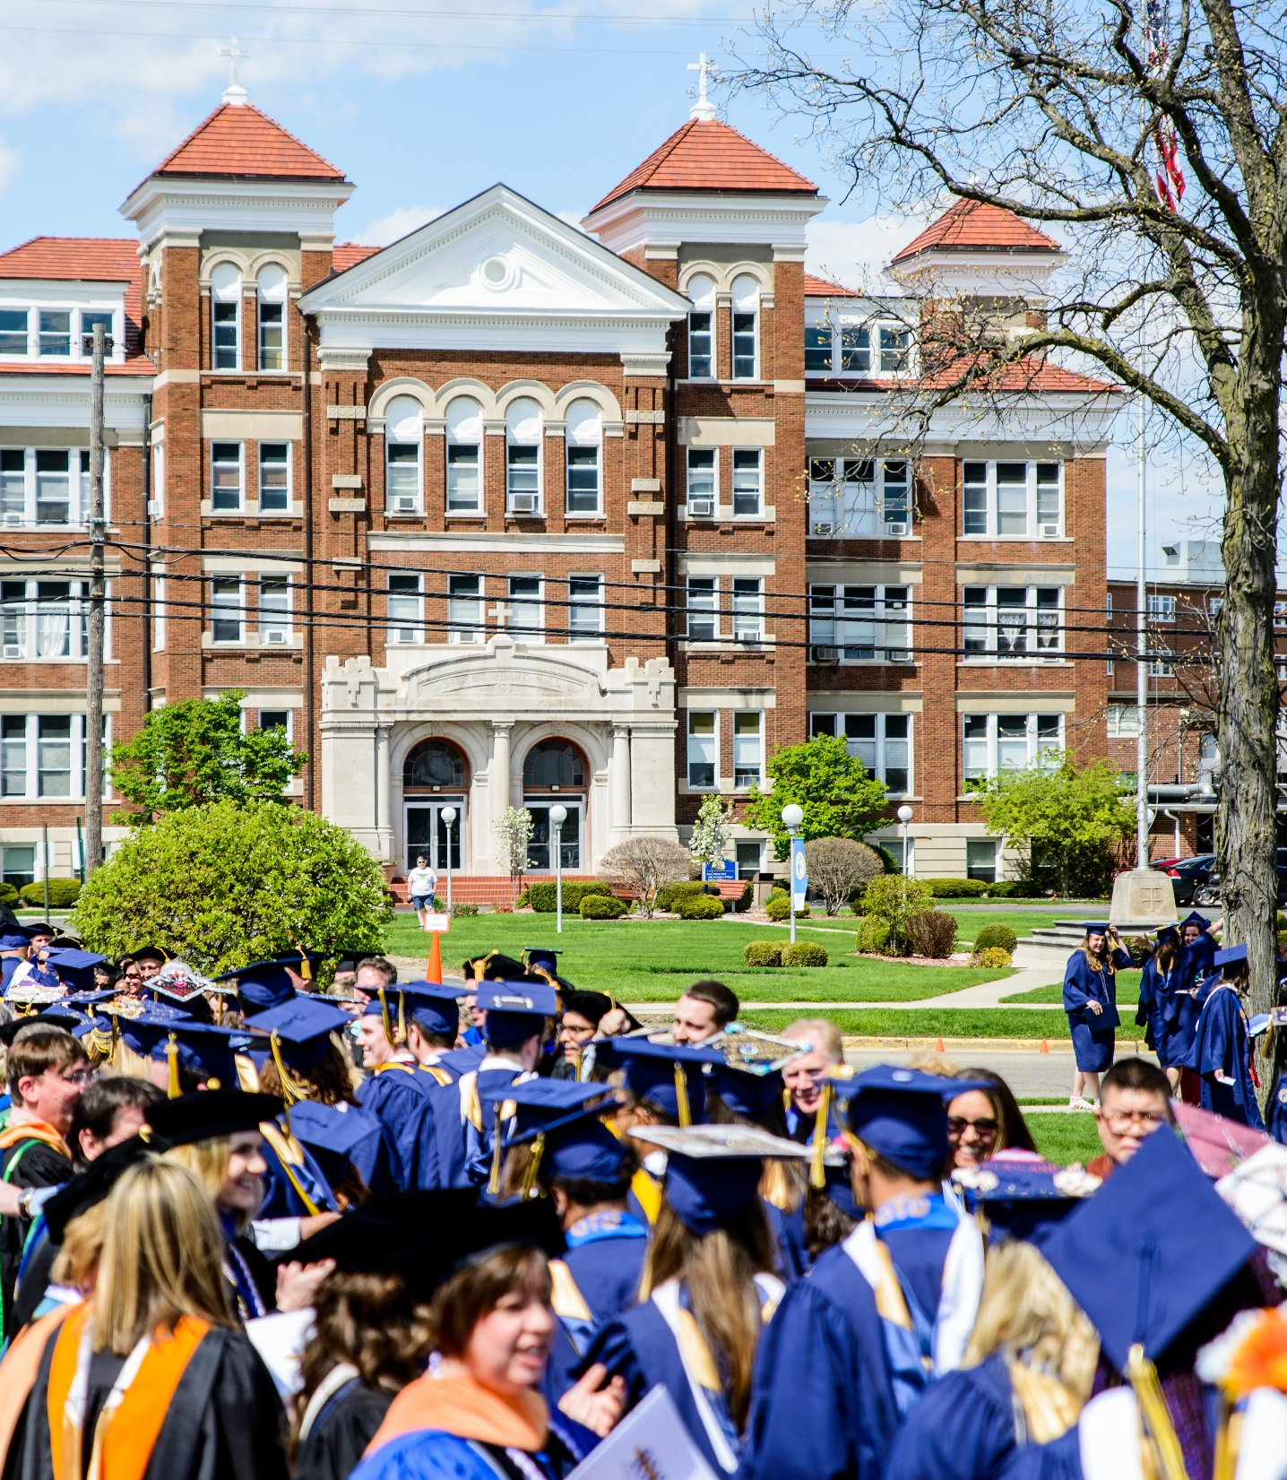
Commencement Early Participation
To participate in May Commencement Ceremony when you have not completed the requirements, you must fulfill the following conditions:
You must be a baccalaureate or master’s degree candidate
Complete the “Application for Graduation” form for SU24 (August)
Be in good academic standing
Be within the last 12 academic hours of graduation
Provide evidence of registration for all remaining coursework
Fill out the Commencement Early Participation Form by Sunday, April 14, 2024

Slide 9
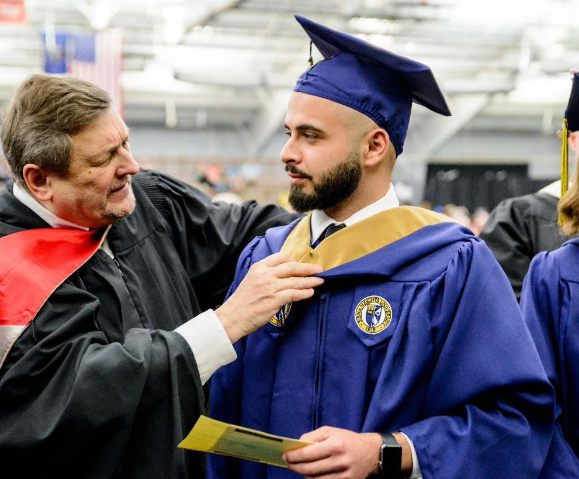
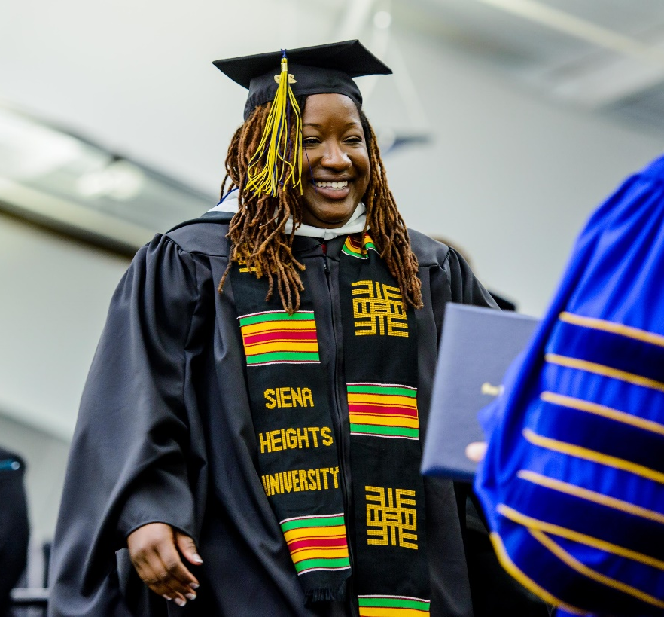
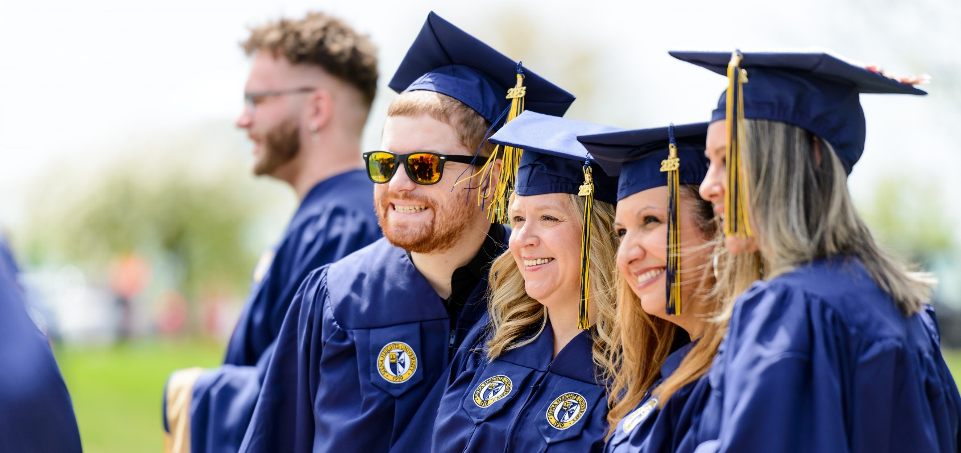
What is “Regalia” and where do I order it?
Regalia is what a graduate wears during the commencement ceremony. This includes: graduation gown, graduation cap, tassel, and hood.
Regalia can be purchased in person at the Adrian campus bookstore or ordered online at: https://oakhallcg.com/pages/sienaheights
Online ordering link will be active until Sunday, April 7, 2024. After that please call the bookstore directly at (517)264-7911.
When ordering online the items will be sent directly to your home w/a shipping fee.
The SHU Bookstore will be open on the day of commencement from 9:00am-5:00pm

Slide 10
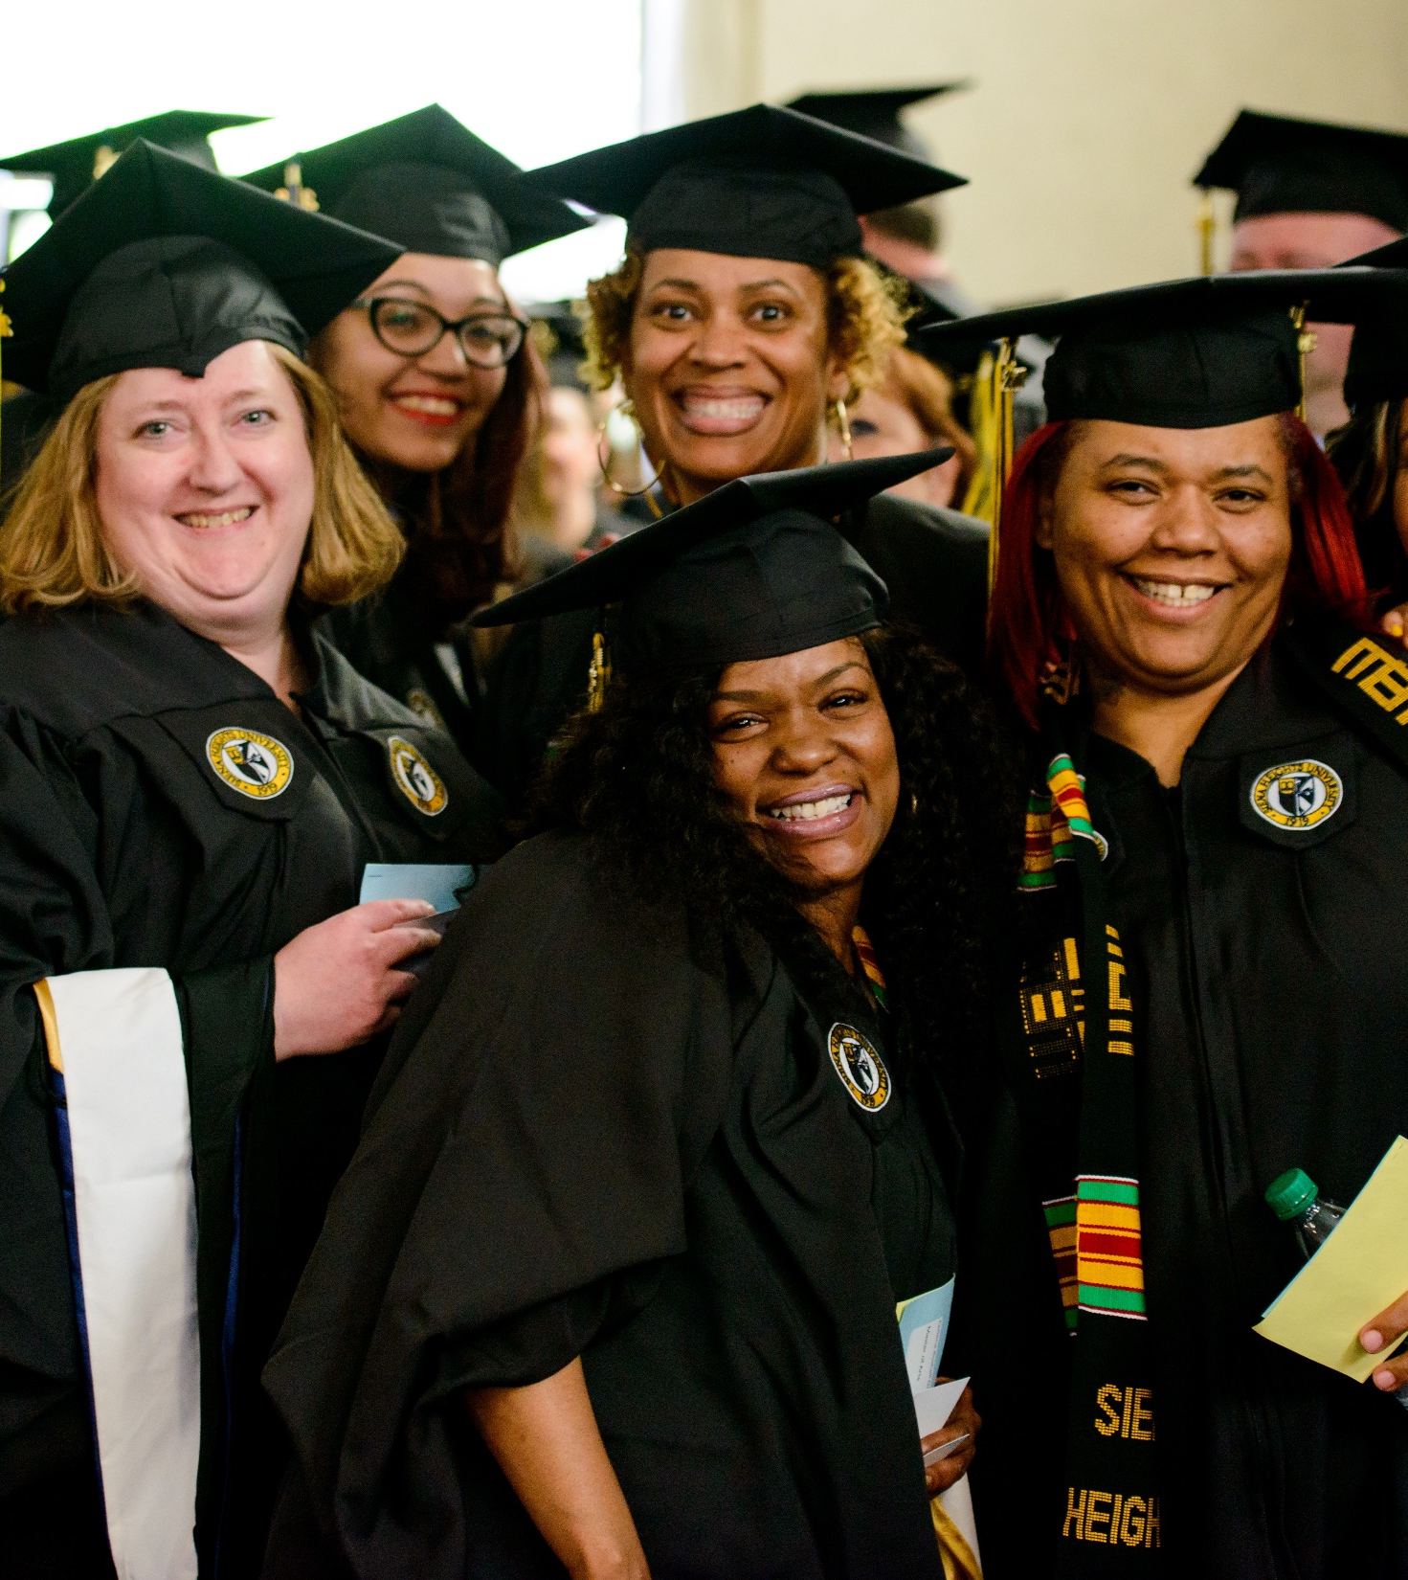
Regalia Packages and Cost
Each package includes cap (one size fits all), gown, hood, and tassel. They can be purchased all together or separately.
Bachelor's degree: $112.92
Master's degree: $121.92
Bachelor gown only: $45.98
Master's gown only: $50.98
Undergraduate hood only: $44.98
Graduate hood only: $48.98
Honor Chords only: $18.98
Cap only: $10.98
Tassel only: $10.98
Keychains only: $8.98
The SHU Bookstore will be open on the day of commencement from 9:00a.m. – 5:00p.m.

Slide 11
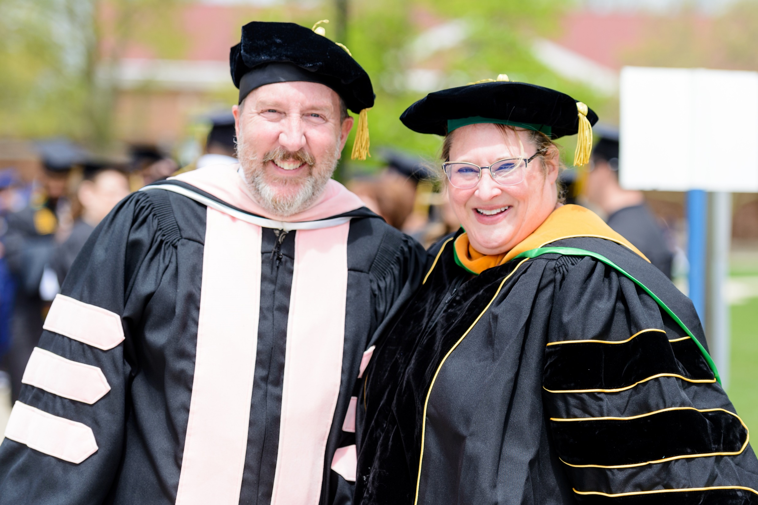
Which hood should I purchase?
Hood colors are based off your degree
BBA - light brown
BFA - dark brown
BA - white
BS - bright yellow
BAS - bright yellow
Nursing - apricot
Social Work - dark gold
Masters – black, white, navy & gold
The SHU Bookstore will be open on the day of commencement from 9:00am – 5:00pm

Slide 12
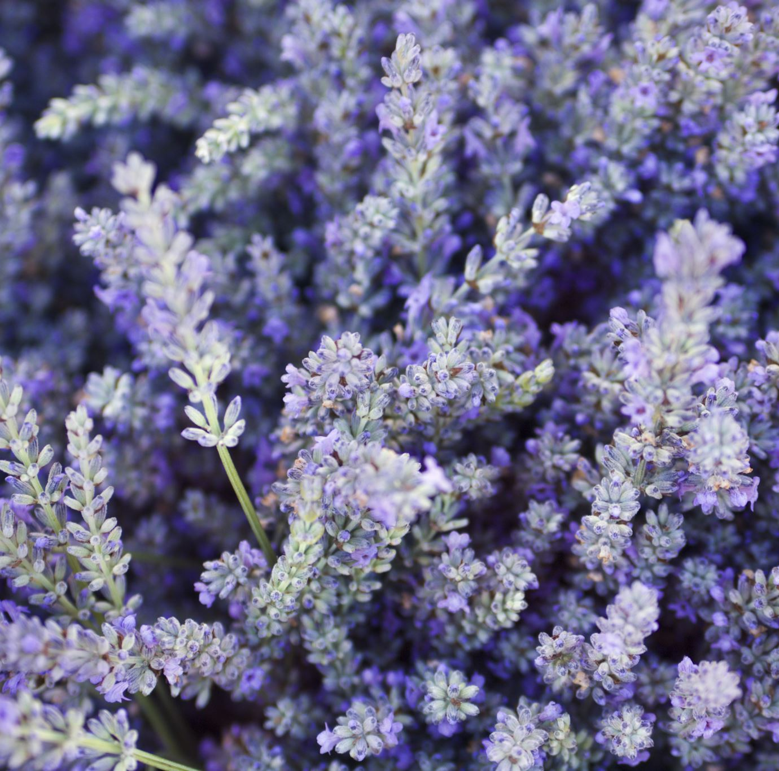
Lavender Ceremony
Thursday, April 25th, 2024
5:30p.m. – 7:00p.m.
Benincasa Hall
RSVP Required

Slide 13
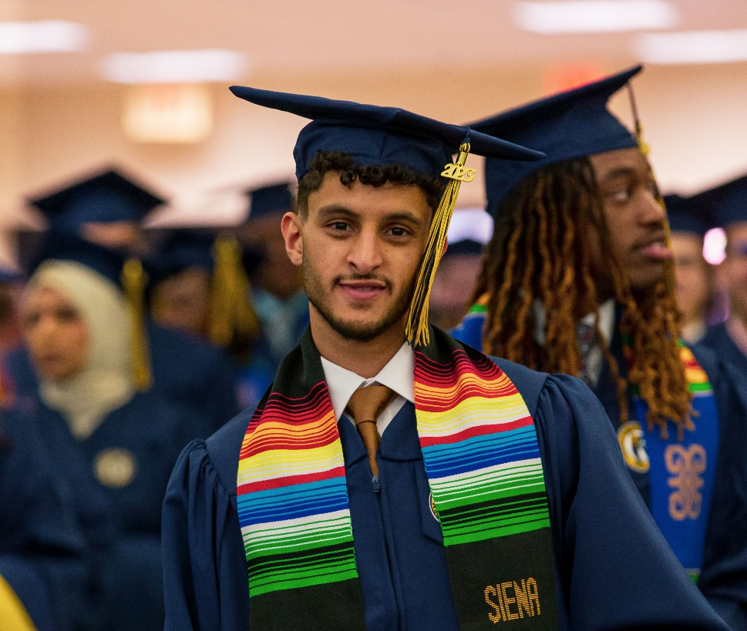
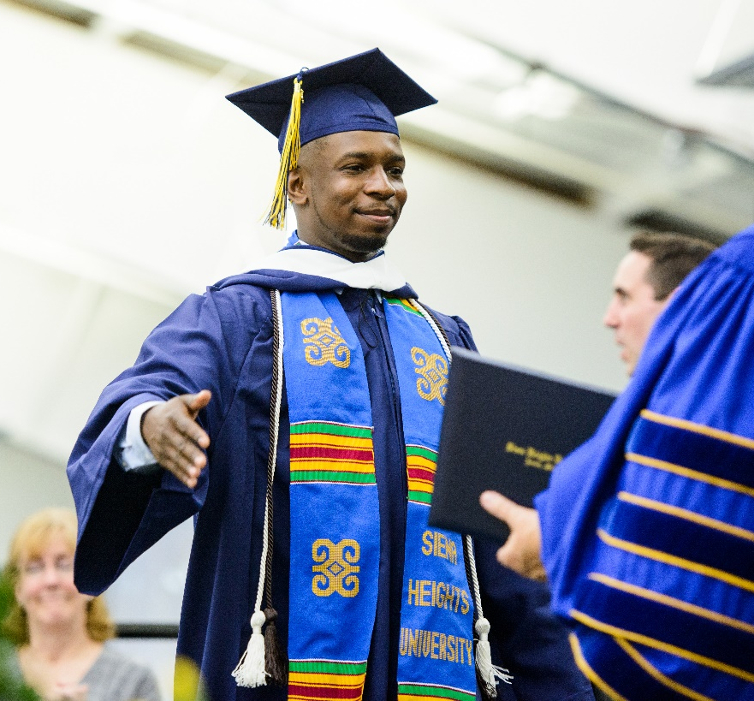
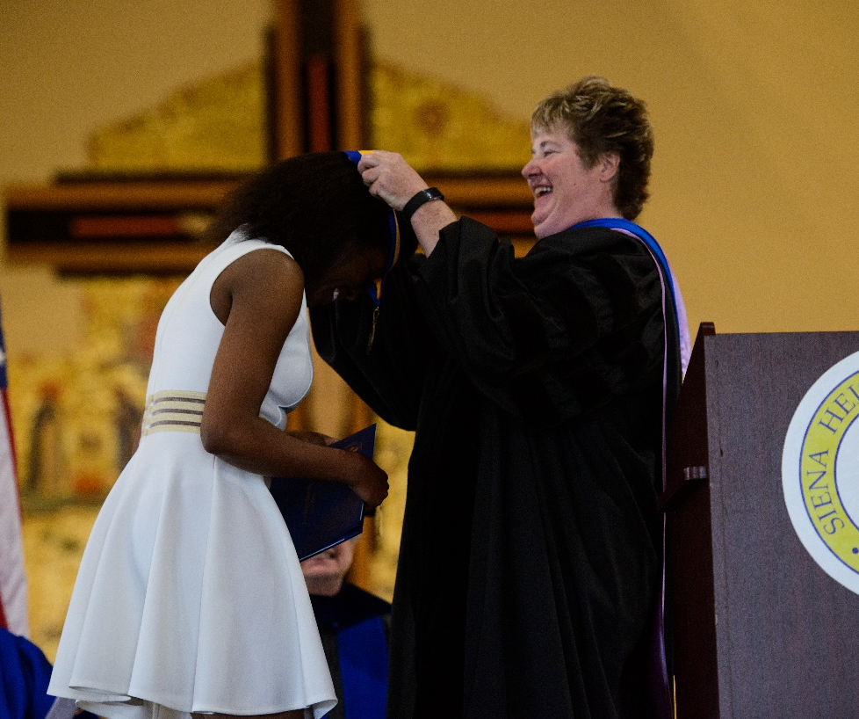
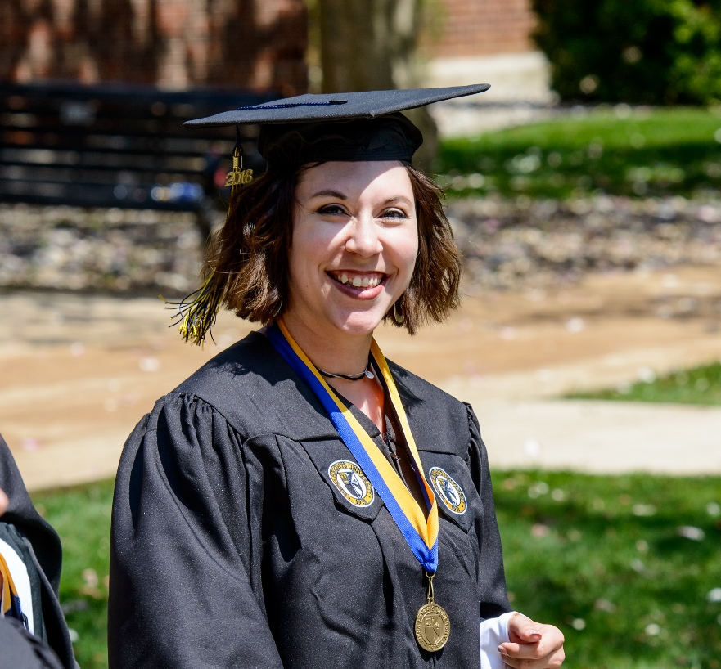
Honors Convocation & Honors Cords
Honors Convocation is an event to recognize and celebrate the academic and service achievements of students
WHEN: Friday, April 26 at 2:00p.m.
WHERE: Performing Arts Center Auditorium and online via Livestream
Honors Cords are awarded by academic division at individual academic celebrations (many which take place after Honors Convocation) Or can be purchased in the bookstore
Honors Cords are worn over the graduation robe for the Commencement Ceremony
*SHU Global students do not have Honor Cords

Slide 14
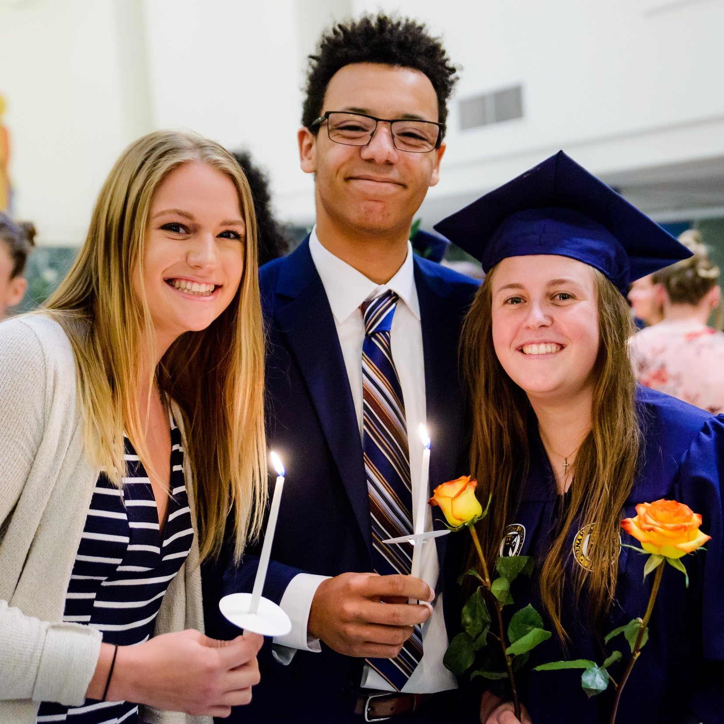
What is Torch Night?
One of Siena Heights’ oldest legacy traditions
The Candle/rose ceremony takes place between graduating students and underclassmen
Graduating seniors will ask an underclassman to be their “Torch” in the ceremony
Each graduating student can select one or two “Torches” in the ceremony
Serves as a symbolic act of underclassmen carrying on the legacy of the graduating seniors
Graduates wear their caps and gowns for this ceremony

Slide 15
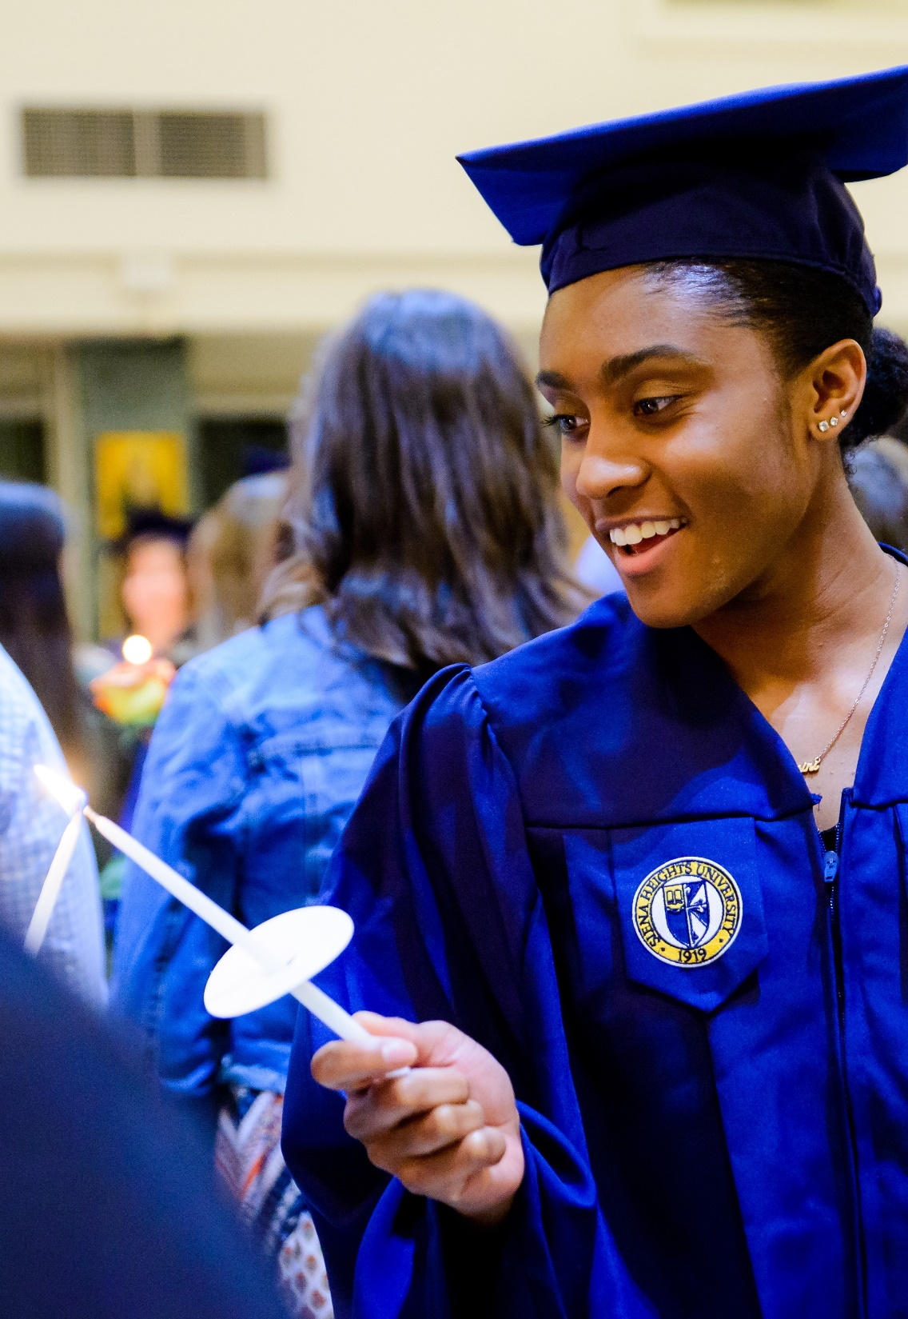
When is Torch Night & How Do I Sign Up?
When: Friday, April 26 at 6:00p.m. in St. Dominic Chapel
To Participate: CLICK HERE
Deadline for online reservations is Friday, April 19th
Questions: Contact PUSH, Thomas Puszczewicz (tpuszcze@sienaheights.edu) at 517-264-7192

Slide 16
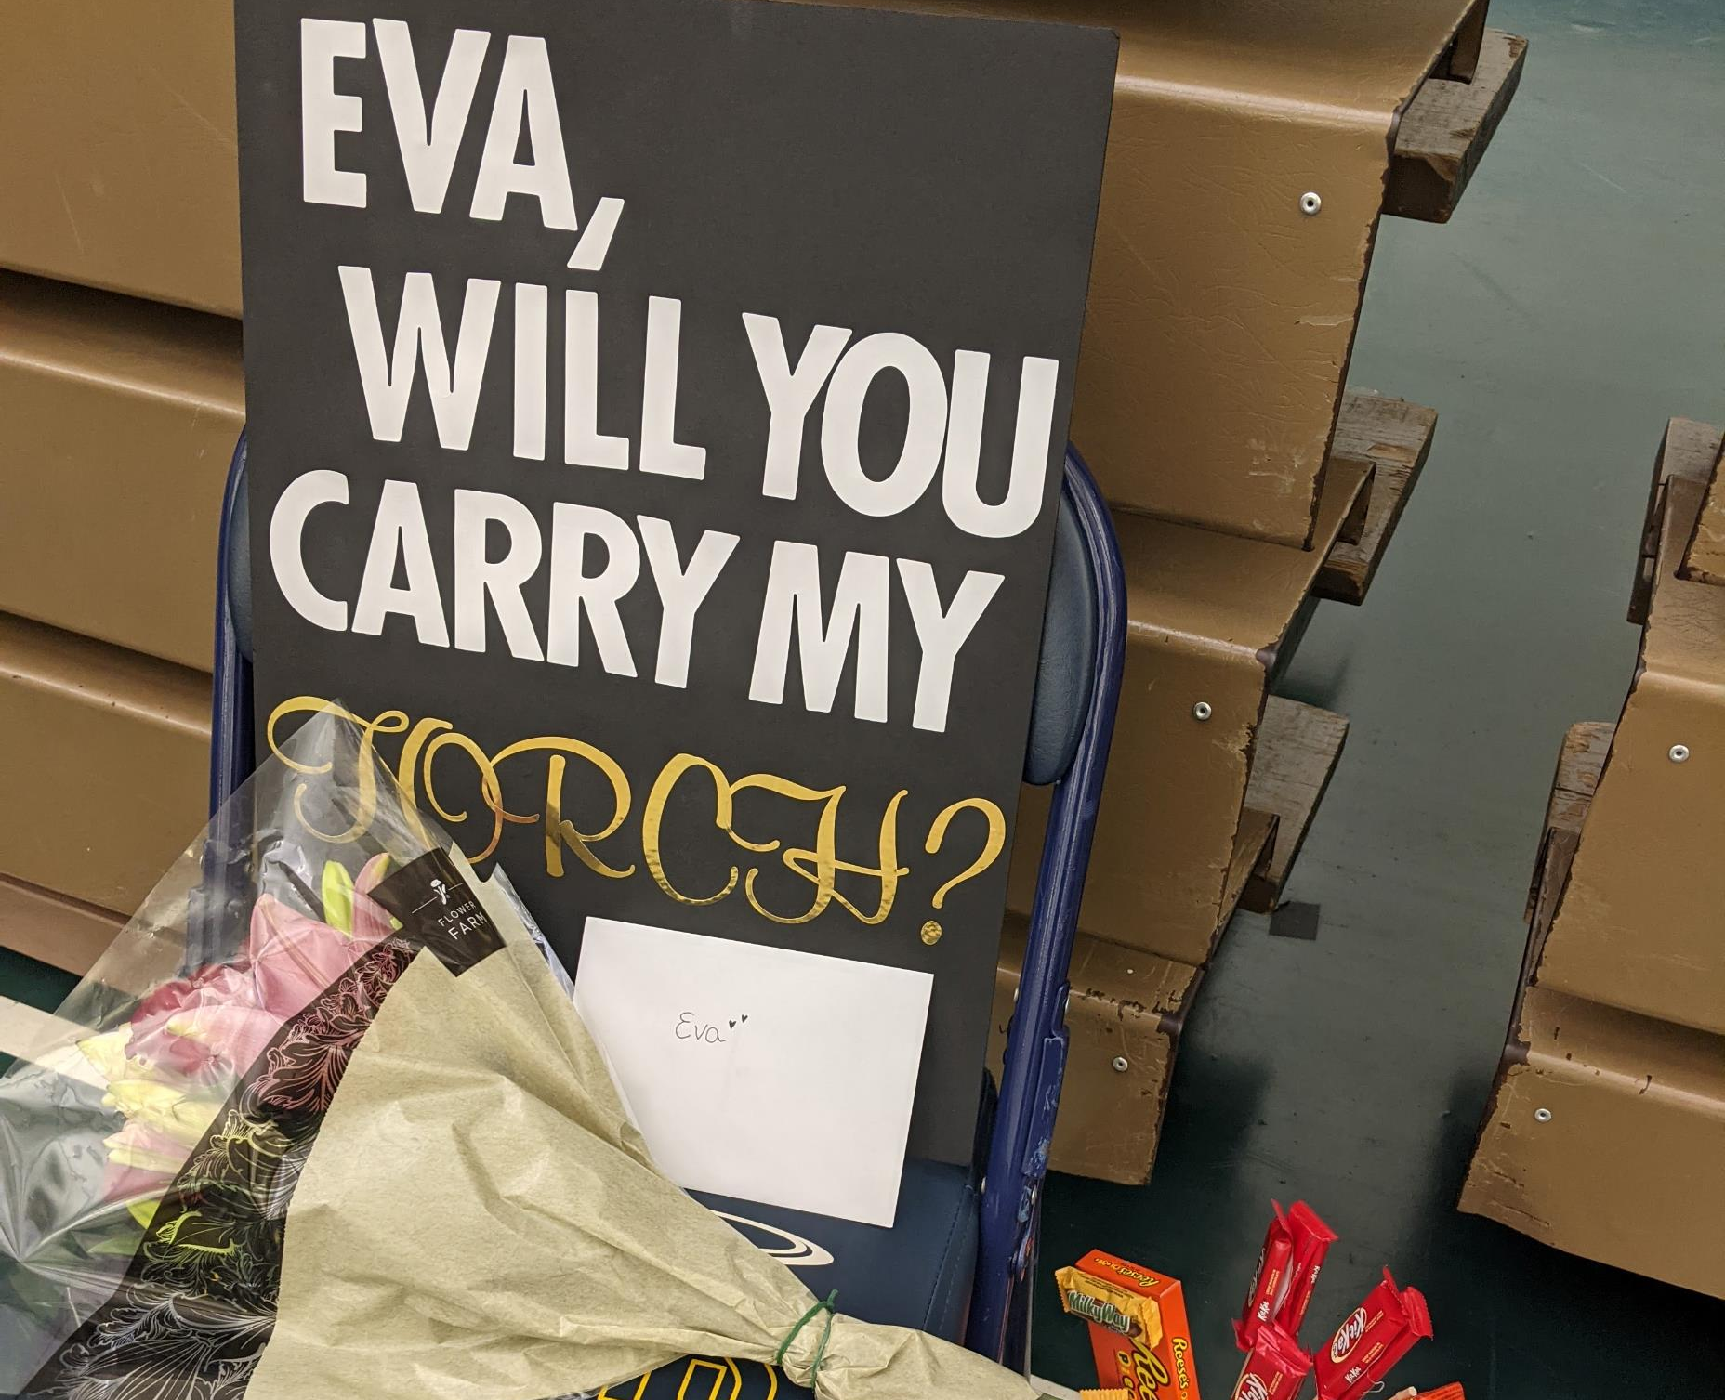
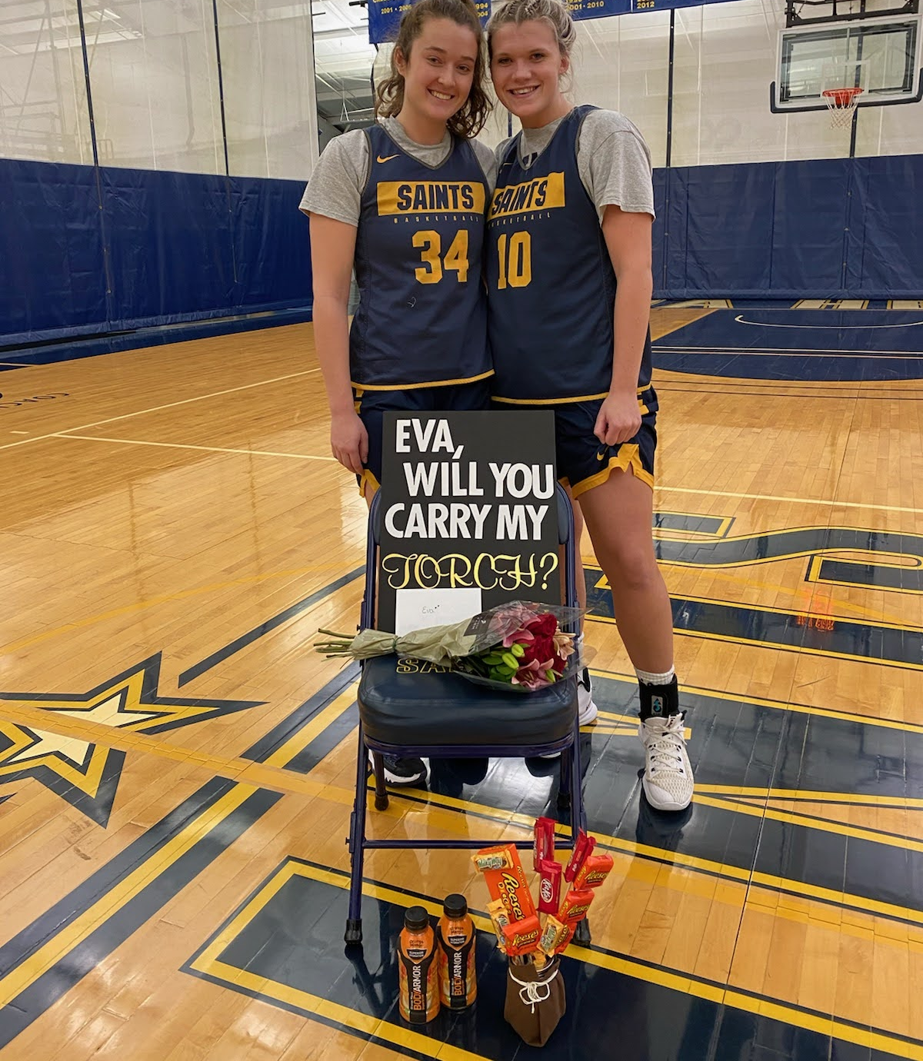
Make a GRAND gesture ☺ Who will you ask to be your torch?

Slide 17
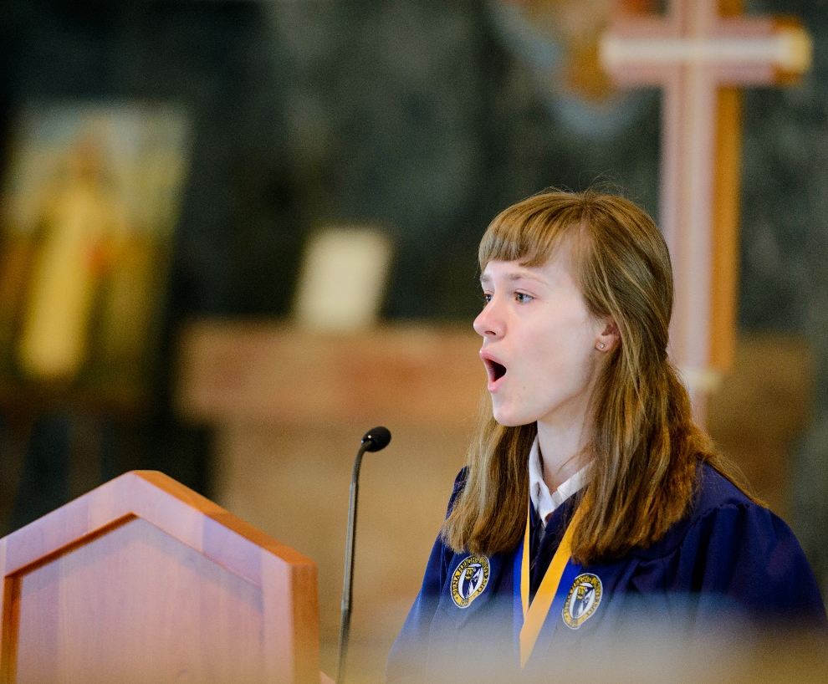
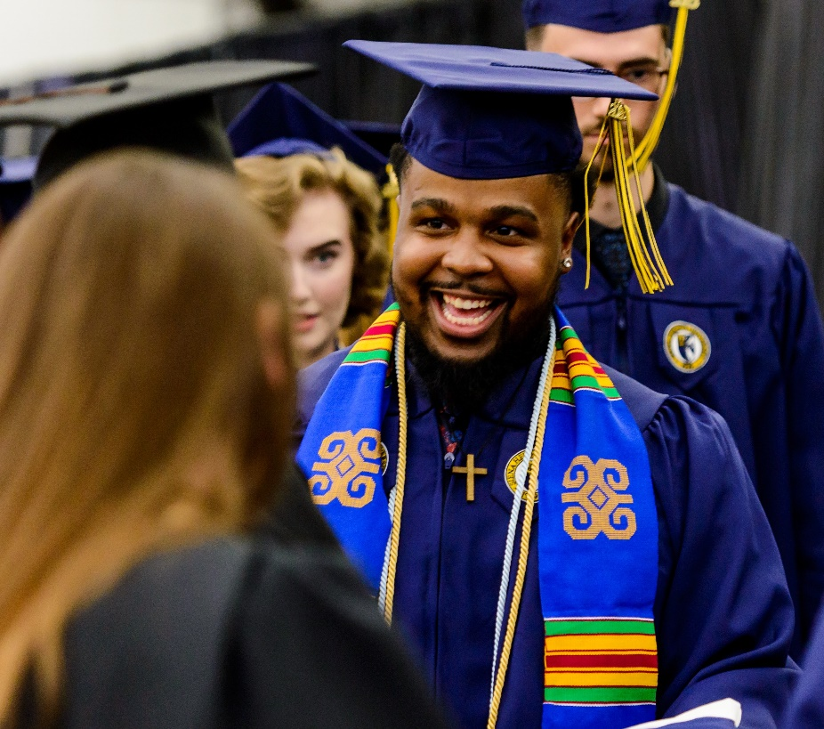
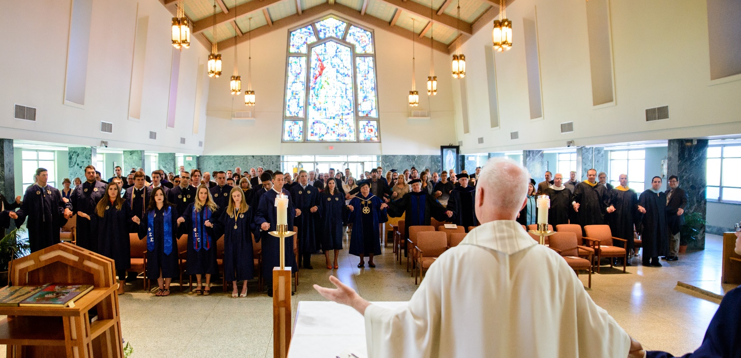
Baccalaureate Mass
Saturday, May 4 from 9:30a.m. – 10:30a.m.
St. Dominic Chapel
In the Catholic Dominican tradition, Siena Heights invites all graduating seniors and their families to begin Commencement day by thanking God with a Baccalaureate Mass.
All graduates who attend receive a cross to wear from our University President, Douglas B. Palmer, PhD.
The cross is a reminder that the God who loves us all is with them as the students go onto the next step of their life journey, wherever it may lead.
The meaning of the word Baccalaureate is “sermon to the graduates.” This year’s preacher and presider is Fr. Michael Newman OSFS, Siena Heights’ chaplain and pastor of Holy Family Parish, Adrian Michigan. In addition, Siena Heights Chamber singers will be leading worship music that day.
Please register yourself, family and guests to attend the service. There is no limit to the people to invite. To register, click here. We are hoping to get an approximate count, but all are welcome, even those who did not register.

Slide 18
Senior Social
Free Food
Sponsored by SHU Student Government
WHEN
Saturday, April 27th
5:00p.m. - 8:00p.m.
WHERE
ZZ's Sports Bar and Grill
Hang out!
Bowl with your
graduating class!
Questions? Email: studentgovernment@sienaheights.edu

Slide 19
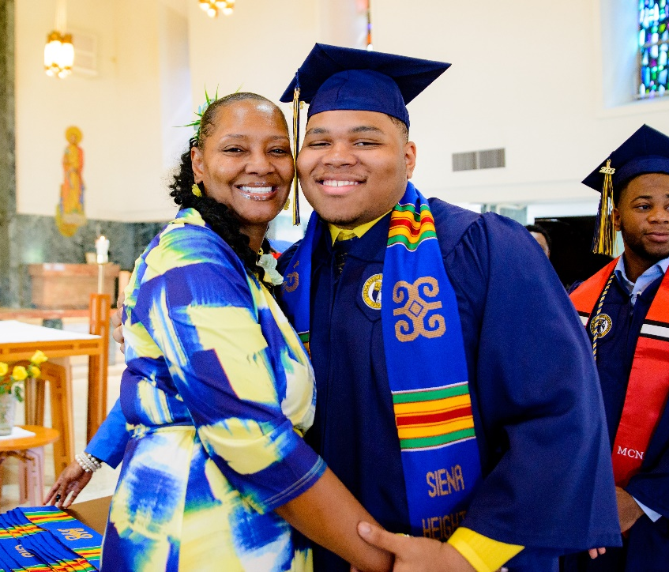
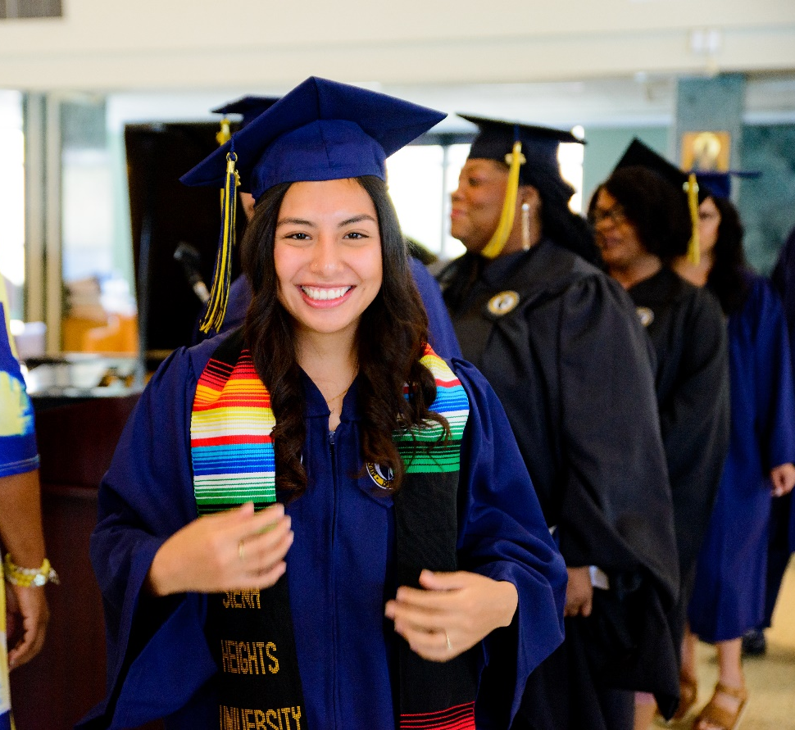
Kente Ceremony
Saturday, May 4 from 11:00a.m. – 12:00p.m.
St. Dominic Chapel
The Kente Ceremony has become a cherished part of commencement for Siena's African American, Hispanic and Latino graduates.
During the ceremony SHU alumni place a Stole on the shoulders of the graduates to be worn over the graduation robe
Kente Stole for African American Graduates
Serape Stole for Hispanic and Latino Graduates
To participate: Click Here or contact Tichina Jones at tjones16@sienaheights.edu or 517-264-7604

Slide 20
MENU Scrambled Eggs Kielbasa with Peppers and Onions Breakfast potatoes Biscuits and Gravy triple berry French Toast Omelet Bar at Halo Grill Tuscan chicken beef and broccoli basmati rice herb infused mashed potatoes steamed green beans vegetable egg rolls dinner rolls Carving station Mustard crusted roast pork loin Salad Bar Assorted Desserts Beverage Bar
Congratulates the Graduating Class of 2024
Celebrate your Graduate with brunch before the ceremony. Join us in the SHU Café located inside the McLaughlin University Center.
May 4th
10:00a.m. – 1:00p.m.
$14.00 Adults $6.00 Children 5-10
Children under 5, free
Reservations recommended for parties larger than six. Call 517-264-7168 or email Peter.Gaiefsky@compass-usa.com.

Slide 21
Career Services
We are here to help you with life after SHU!
Resume & Cover Letter Review
Graduate & Professional School Assistance
Job Search Tips and Interviewing Skills
Branding and Networking
Connect with a staff member to discuss your next professional step: http://sites.sienaheights.edu/careerservices

Slide 25
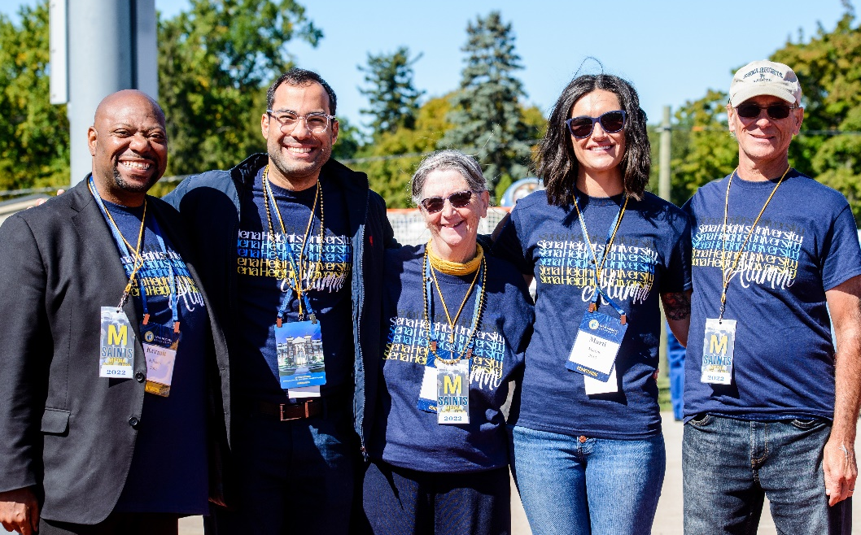
Welcome to the Alumni Association!
Ticket exchange booth will be available outside the Fieldhouse on Saturday of commencement
Drop off extra tickets or pick up more for family and friends – start time is TBD
Stay in touch
Update contact information
Join the Siena Heights University Alumni Facebook Page & the Siena Heights University Alumni LinkedIn Group (private groups for alumni only)
Join the Alumni Board
Questions, contact the alumni office at alumni@sienaheights.edu

Slide 26
Congratulations, and thank you for attending!
All links mentioned in this presentation are available on the Commencement Information and Registration site.
Keep an eye on the SHU Announcements for any updates/reminders
Still have unanswered questions about graduation or commencement? Please reach out to Conni Marquez at cmarquez@sienaheights.edu

