Slide 1
Need for Speed...Reading
Reading Strategies for the college student under pressure

Slide 2
Six Reading Myths
Six Myths About Reading You Should Know
You have to read every word
You may have to read more than once
You cannot skip parts of the text
You must force yourself to read faster
You can read while distracted
It is all about the eyes
Notes:
You do NOT have to read every word.
You read your text once, but your notes multiple times!
It IS okay to skip parts of the text.
You cannot force yourself to read faster, and comprehend better. This is both genetics and practice (with consistency).
Distractions really do interfere with reading speed, and more importantly comprehension, because....
Your eyes are likely fine, it’s your brain slowing you down.

Slide 3
How and What we Read
In general, we read certain things a certain way, and we can apply this to educational reading too.
Scanning
Skimming
Active/ Detailed
Speed
Structure-Proposition-Evaluation
Notes:
Scanning: This technique is automatically being used by everyone who has tried to find a person in a telephone book. You simply browse through the book, looking for a specific piece of information. It's helpful to have several signal words written down, e.g. snow, sledge, Coca-Cola.
Skimming: Have you ever read an article in a newspaper or magazine? Well, if you didn't notice, you are just skimming the text. Smaller details are being disregarded and you simply focus on the main words, which is enough to get the meaning of the article. This technique is great for obtaining a first impression of an article to see if it is actually relevant to you or not.
Active/Detailed: You skim a text first and then you go through it in detail. Paying attention to every single word and extracting important information from the text.
Speed: Here, you simply try to improve your reading speed without losing any understanding of the text. It's quite difficult and requires a lot of practice. The main aspects of Speed Reading are:
Identifying words without focusing on each letter
Not to sounding-out all words
Not sub-vocalizing some phrases
Spending less time on some phrases than others
Skimming small sections
S/P/E: This technique is only applicable to non-fiction writing. You simply have to stick to those three steps:
Review the table of contents, paragraphs of the article or layout of the text
Study the statements of the text and put them in logical order or relation to each other
Evaluate the final arguments and conclusions of the text

Slide 4
Reading Strategies for Smart Students
Following are several reading strategies you can employ now. They do not require faster speed, only consistency. Not every strategy will work for every person, but that is the beauty of strategies, not strategy!
Let’s Go...

Slide 5
The “No Reading” Method
Title
Entries in the margin
List of content
Words in bold
Headings
Textboxes
Subordinate headings
Figures, graphs, models
Preface
Abstracts in the text
Text on the back of the book
Index
Illustrations
Index of names

Slide 6
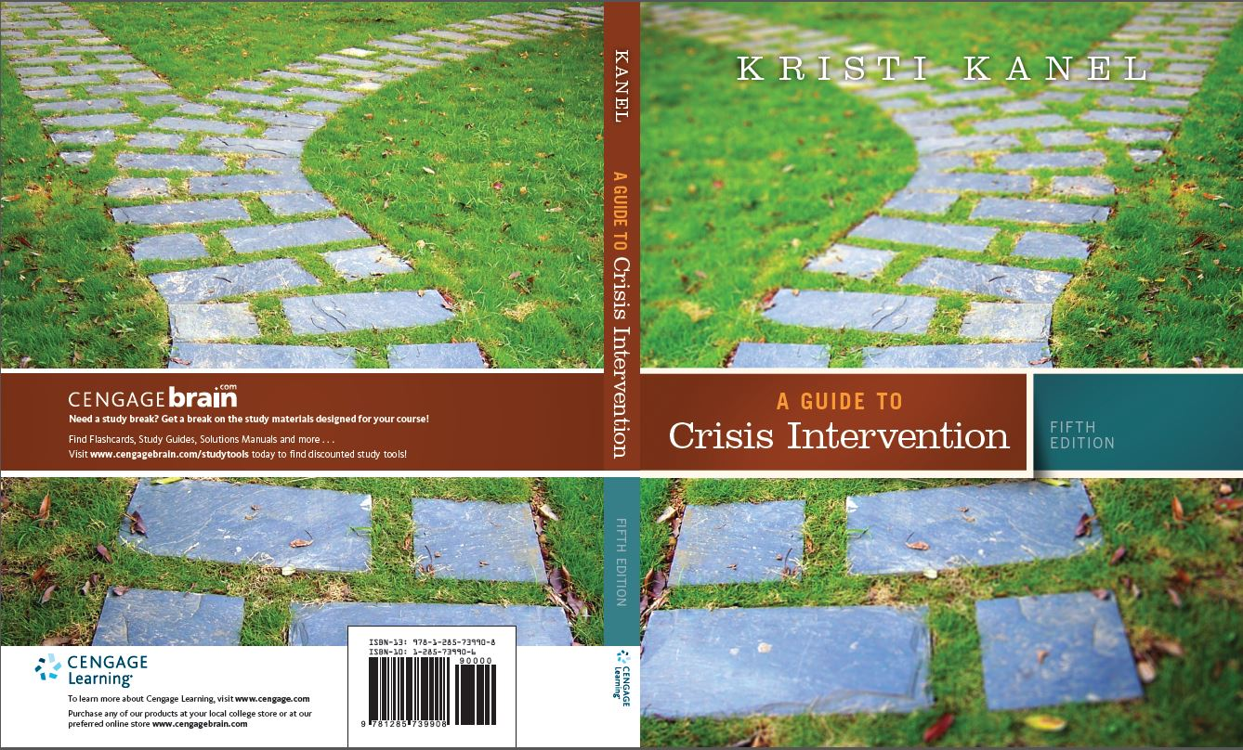

Slide 7
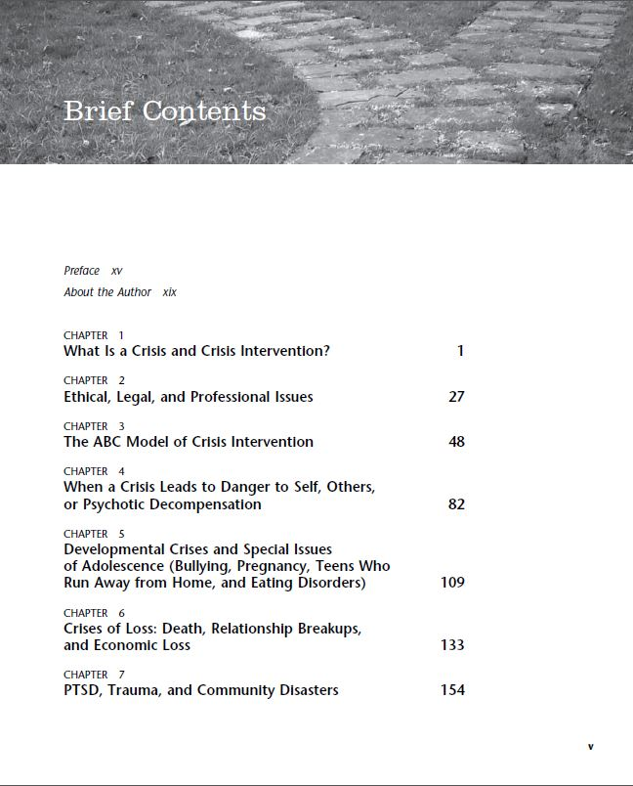
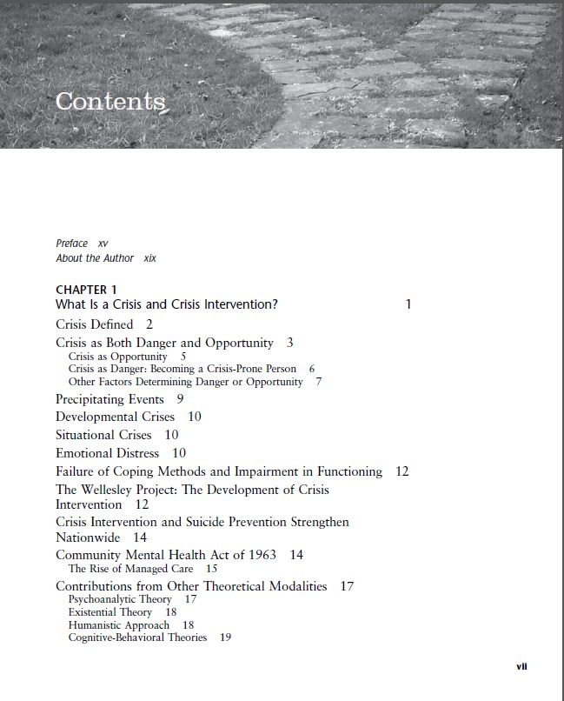

Slide 8
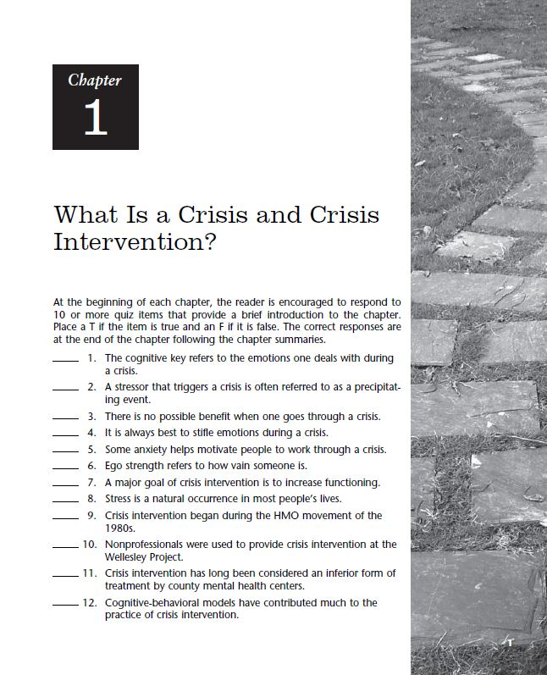
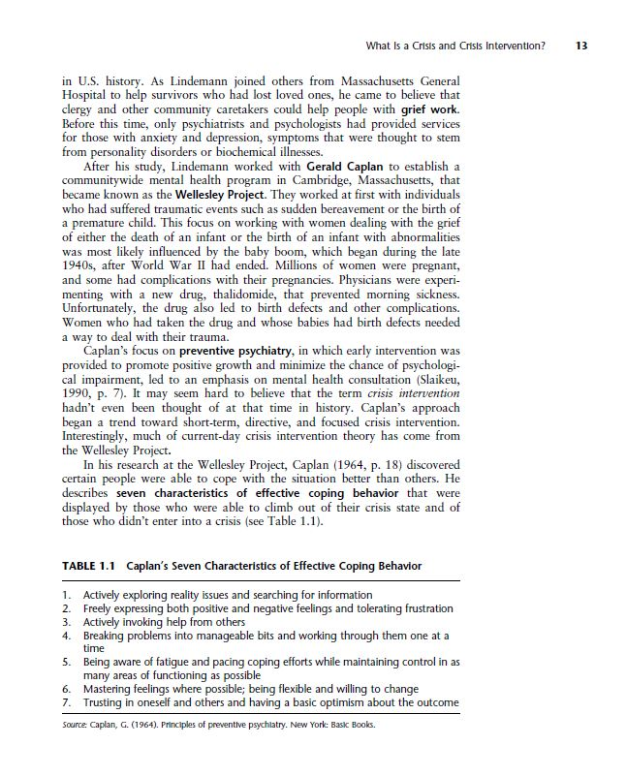

Slide 9
S.P.O.R.T. Method
Say to yourself “Where did I see this information?”
Picture what you read.
Organize in your mind all your study aids.
Remember to “dump” information (fill the margins).
Tell yourself to go back to the “dumped” info.

Slide 10
SQ3R Method
Survey
Survey the entire chapter by scanning the titles, headings, pictures, and chapter summaries—get a general idea of the reading material
Question
As you survey, also be asking yourself questions about the reading and information
Read
Read for comprehension (you can break this into sections and time limits)
Recite
Review
Notetaking, and answering your questions from above (verbally or in writing) can transfer information to the long-term memory parts of your brain
Summarize the main ideas and concepts and review the key learning concepts in your notes/reading material

Slide 11
The Notetaking Method
Notes help you organize the ideas and help you make meaning out of something about which you may not be familiar. Taking notes also helps you stay focused on the question at hand.
Notes can act as a study guide
Notes are a “work in progress”
Learn what notes work for your classes (not every notetaking style works for every class...)
Review, redo, review
Summarize your notes (this helps with comprehension)
Define key terms
Draw connections between different concepts (such as cause and effect)
Paraphrase concepts or quotations
Ask yourself questions, use answers in notes
Noting questions to ask your instructor/answers during office hours

Slide 12
Types of Notetaking for Reading Success
Outlining
Cornell
Charts or Tables
Concept Mapping, Graphic Visuals, and Drawing Notes

Slide 13
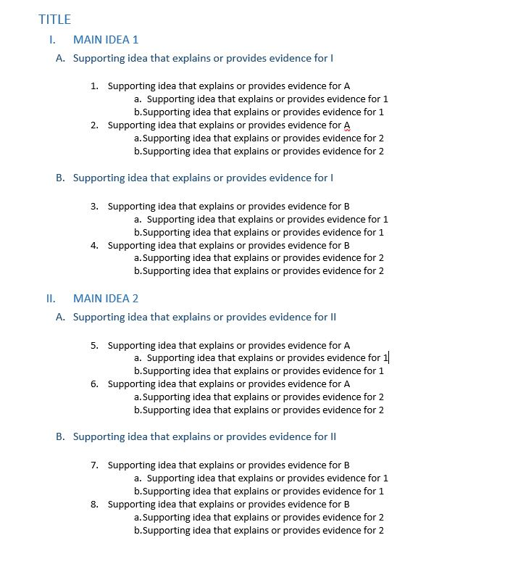
Outlining
TITLE
MAIN IDEA 1
Supporting idea that explains or provides evidence for I
Supporting idea that explains or provides evidence for A
Supporting idea that explains or provides evidence for 1
Supporting idea that explains or provides evidence for 1
Supporting idea that explains or provides evidence for A
Supporting idea that explains or provides evidence for 2
Supporting idea that explains or provides evidence for 2
Supporting idea that explains or provides evidence for I
Supporting idea that explains or provides evidence for B
Supporting idea that explains or provides evidence for 1
Supporting idea that explains or provides evidence for 1
Supporting idea that explains or provides evidence for B
Supporting idea that explains or provides evidence for 2
Supporting idea that explains or provides evidence for 2
MAIN IDEA 2
Supporting idea that explains or provides evidence for II
Supporting idea that explains or provides evidence for A
Supporting idea that explains or provides evidence for 1
Supporting idea that explains or provides evidence for 1
Supporting idea that explains or provides evidence for A
Supporting idea that explains or provides evidence for 2
Supporting idea that explains or provides evidence for 2
Supporting idea that explains or provides evidence for II
Supporting idea that explains or provides evidence for B
Supporting idea that explains or provides evidence for 1
Supporting idea that explains or provides evidence for 1
Supporting idea that explains or provides evidence for B
Supporting idea that explains or provides evidence for 2
Supporting idea that explains or provides evidence for 2

Slide 14
Cornell Method
Note Taking Area: Record lecture as fully and as meaningfully as possible.
Cue Column: As you're taking notes, keep cue column empty. Soon after the lecture, reduce your notes to concise jottings as clues for Reciting, Reviewing, and Reflecting.
Summaries: Sum up each page of your notes in a sentence or two.
This format provides the perfect opportunity for following through with the 5 R's of note-taking:
Record During the lecture, record in the main column as many meaningful facts and ideas as you can. Write legibly.
Reduce As soon after as possible, summarize these facts and ideas concisely in the Cue Column. Summarizing clarifies meanings and relationships, reinforces continuity, and strengthens memory.
Recite Cover the Note Taking Area, using only your jottings in the Cue Column, say over the facts and ideas of the lecture as fully as you can, not mechanically, but in your own words. Then, verify what you have said.
Reflect Draw out opinions from your notes and use them as a starting point for your own reflections on the course and how it relates to your other courses. Reflection will help prevent ideas from being inert and soon forgotten.
Review Spend 10 minutes every week in quick review of your notes, and you will retain most of what you have learned.
Adapted from How to Study in College 7/e by Walter Pauk, 2001 Houghton Mifflin Company

Slide 15
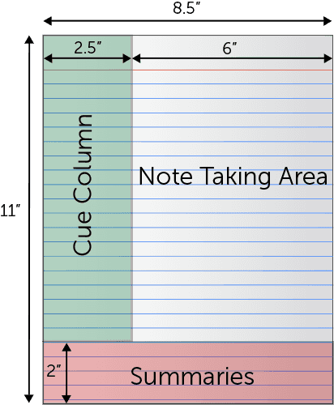

Slide 16
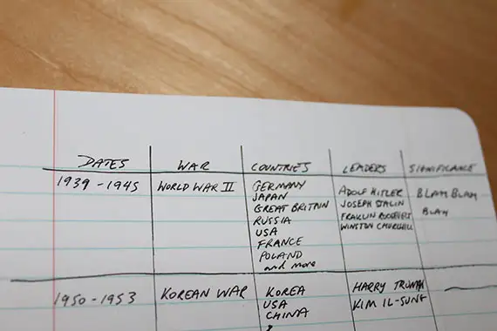
Charts and Tables
The charting method is good for taking notes on subjects that have:
Factual and/or statistical information;
Subtopics that are directly comparable to each other;
Information that can be compartmentalized into tables.
HOW TO BASICS:
Identify the topics and categories
Insert the topic, subtopics, and categories into the chart
Fill in the chart with notes
Review and/or Recite the information from chart (no need to re-read)
MAIN TOPIC/CHAPTER | Subtopics/Places/Names | Sections/People/Etc.
Topics and Categories | NOTES | NOTES
Dates | NOTES | NOTES

Slide 17
As a territory, Michigan had remained relatively unexplored and unexploited. Protected on its flanks by the sometimes stormy and uncertain waters of the Great Lakes, the territory seemed remote and inaccessible, far from the main- stream of western expansion. Michigan’s reputation as a land of swamps and sickness whose very name was synonymous with “ague, fever, and chills” served as a further deterrent to growth.
Despite these handicaps, Michigan’s early years of statehood saw an enormous population increase. during the 1830s a flood of immigration sent the population soaring to over 212,000—the greatest growth for any state or territory during the decade. By 1850 Michigan had nearly 398,000 residents, of whom 14 percent were foreign born.
Two developments in transportation had a profound impact on the state’s population explosion. First, in 1811 Robert Fulton sailed his new invention, the steamboat, and within seven years the Walk-in-the-Water was plying the Great Lakes between Buffalo and Detroit. Although this first lake-steamer was wrecked in a storm three years after its launching, others soon followed, bring- ing new settlers to Michigan. Second, in 1825 new York’s Erie Canal was completed, stretching 350 miles from Albany, on the Hudson River, to Buffalo, on Lake Erie. its opening meant that potential settlers living in new England and new York could make much of their journey inland by water and that Michigan products would have an easier access to Eastern markets.
Michigan: A History of the Great Lakes State, Fifth Edition. Bruce A. Rubenstein and Lawrence E. Ziewacz.
© 2014 John Wiley & Sons, Inc. Published 2014 by John Wiley & Sons, Inc.

Slide 18
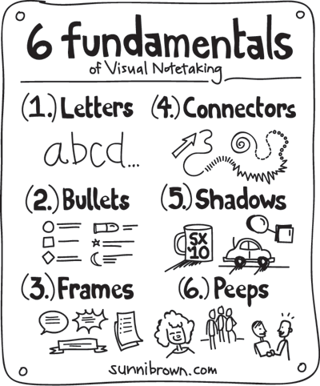
Concept Mapping, Graphic Visuals, and Drawing Notes
The mapping method of note-taking provides a graphical representation of information, ideas, facts, and concepts. The format involves writing the main topic into the center of the document and connecting related subtopics, ideas, and concepts through branches, images, and colors.
TOPIC
Subtopic
Supporting Evidence
Subtopic
Supporting Evidence
Supporting Evidence
Supporting Evidence
Topic
Subtopic
Subtopic
Subtopic
Related Idea
Related Idea
Related Idea
Related Idea
Related Idea

Slide 19
Test Our Skills
https://swiftread.com/reading-speed-test#speed-reading-test
Please use the link in the chat to go to this site
How did you do? Were you where you thought you would be? What about your comprehension??

Slide 20
Are you Ready?
Read sitting up with good light, and at a desk or table.
Keep background noise to a minimum. Loud rock music will not make you a better reader. The same goes for other distractions: talking to roommates, kids playing nearby, television or radio. Give yourself a quiet environment so that you can concentrate on the text.
Keep paper and pen within reach.
Survey the reading. Look at the title of the piece, the subheadings. What is in the dark print or stands out? Are there illustrations or graphs?
Strategize your approach: read the introduction and conclusion, then go back and read the whole assignment, or read the first line in every paragraph to get an idea of how the ideas progress, then go back and read from the beginning.
Scan effectively: scan the entire reading, and then focus on the most interesting or relevant parts to read in detail.
Get a feel for what's expected of you by the reading. Pay attention to when you can skim and when you need to understand every word.
Write as you read. Take notes and talk back to the text. Explain in detail the concepts. Mark up the pages. Ask questions. Write possible test questions. Write down what interests or bores you. Speculate about why.
If you get stuck: think and write about where you got stuck. Contemplate why that particular place was difficult and how you might break through the block.
Record and explore your confusion. Confusion is important because it’s the first stage in understanding.
Break long assignments into segments. Read 10 pages (and take notes) then do something else. Later, read the next 10 pages and so on.
Read prefaces and summaries to learn important details about the book. Look at the table of contents for information about the structure and movement of ideas. Use the index to look up specific names, places, ideas.
(Reading strategies by Dr. Kathleen King. Many of the above ideas are from a lecture by Dr. Lee Haugen, former Reading specialist at the ISU Academic Skills Center. https://www.ghc.edu/sites/default/files/StudentResources/documents/learn...)

